Slide 1
01
大模型推理框架

Slide 2
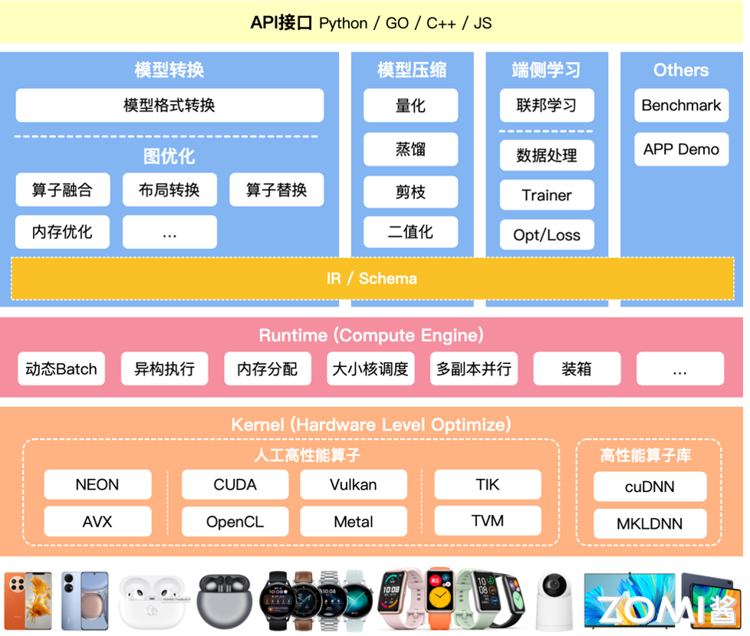
传统推理引擎

Slide 3
LLLM 推理引擎&服务化

Slide 4

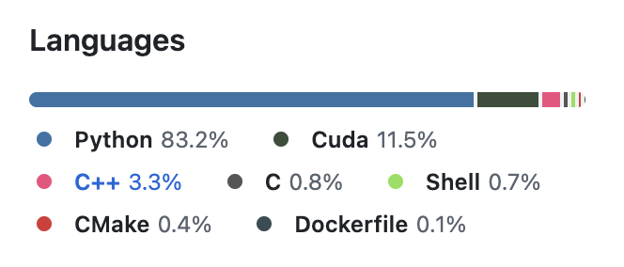
VLLM
https://github.com/vllm-project/vllm

Slide 5
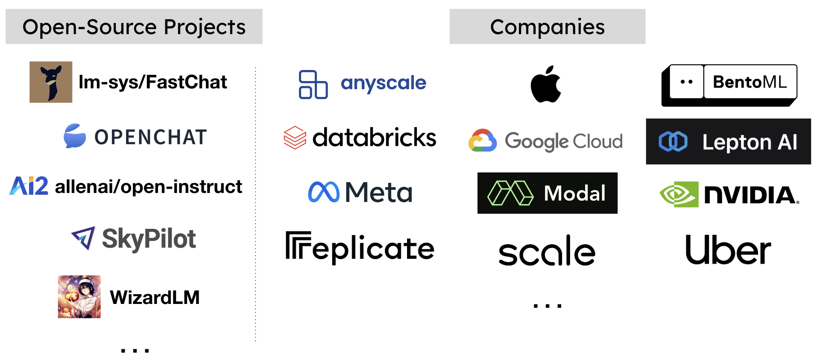
vLLM Adopters

Slide 6
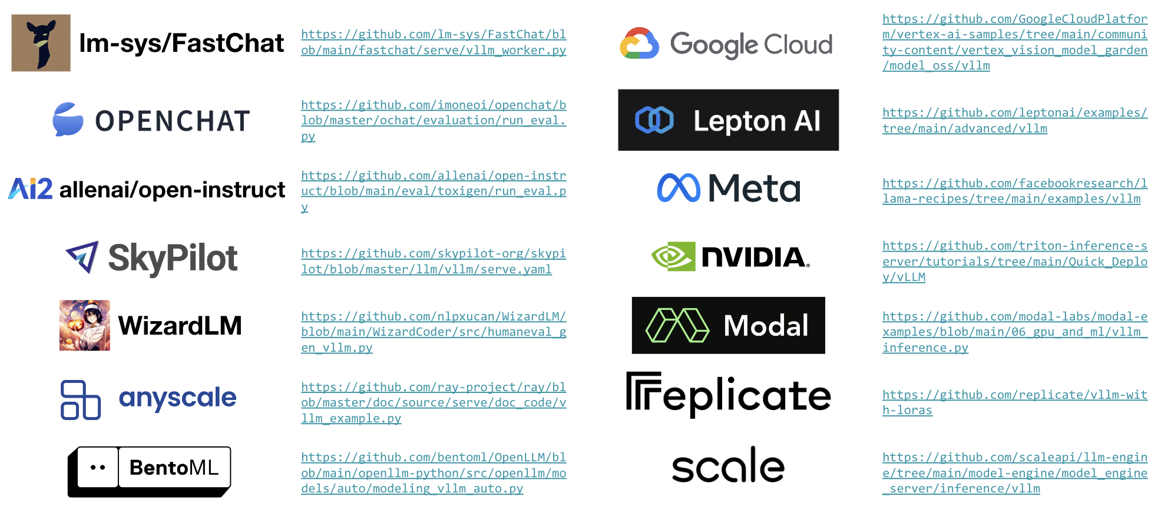
vLLM Adopters

Slide 7
VLLM
vLLM 是一个 LLM (Large Language Model) 推理和部署服务库，结合 iterative-level schedule (continuous batching) 和 Paged Attention 以提高吞吐量：
iterative-level schedule 以单轮迭代方式对用户的请求进行处理，即 LLM 生成一个 token 后会重新调度下一轮要处理的请求
Paged Attention 受操作系统虚拟内存和分页思想启发，将原本连续的 KV cache 存储在不连续的空间，以避免 KV cache 带来的显存浪费

Slide 8
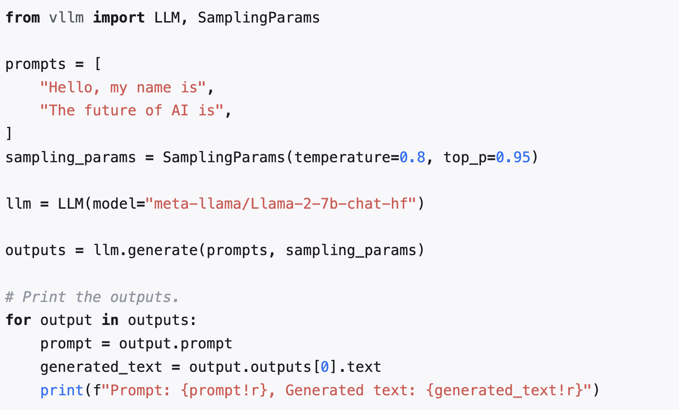
VLLM

Slide 9
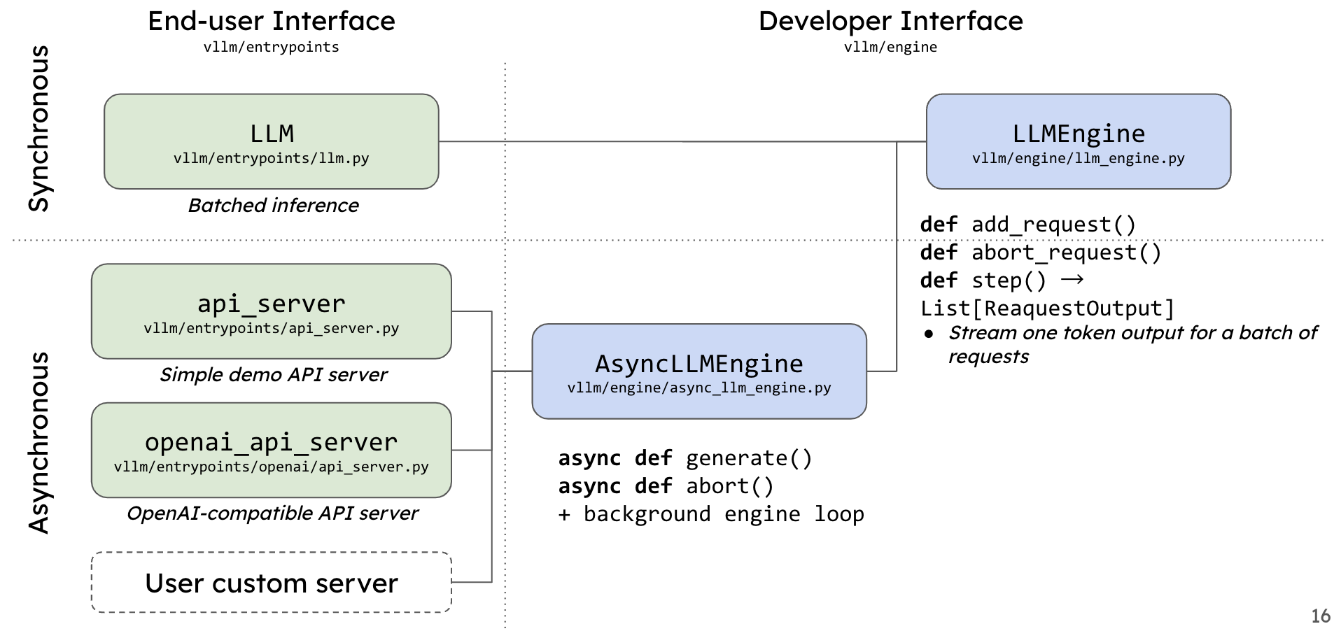
vLLM User Interface
核心组件是 LLMEngine 类，外层接口类 LLM 和 AsyncLLMEngine 都是对 LLMEngine 封装

Slide 10
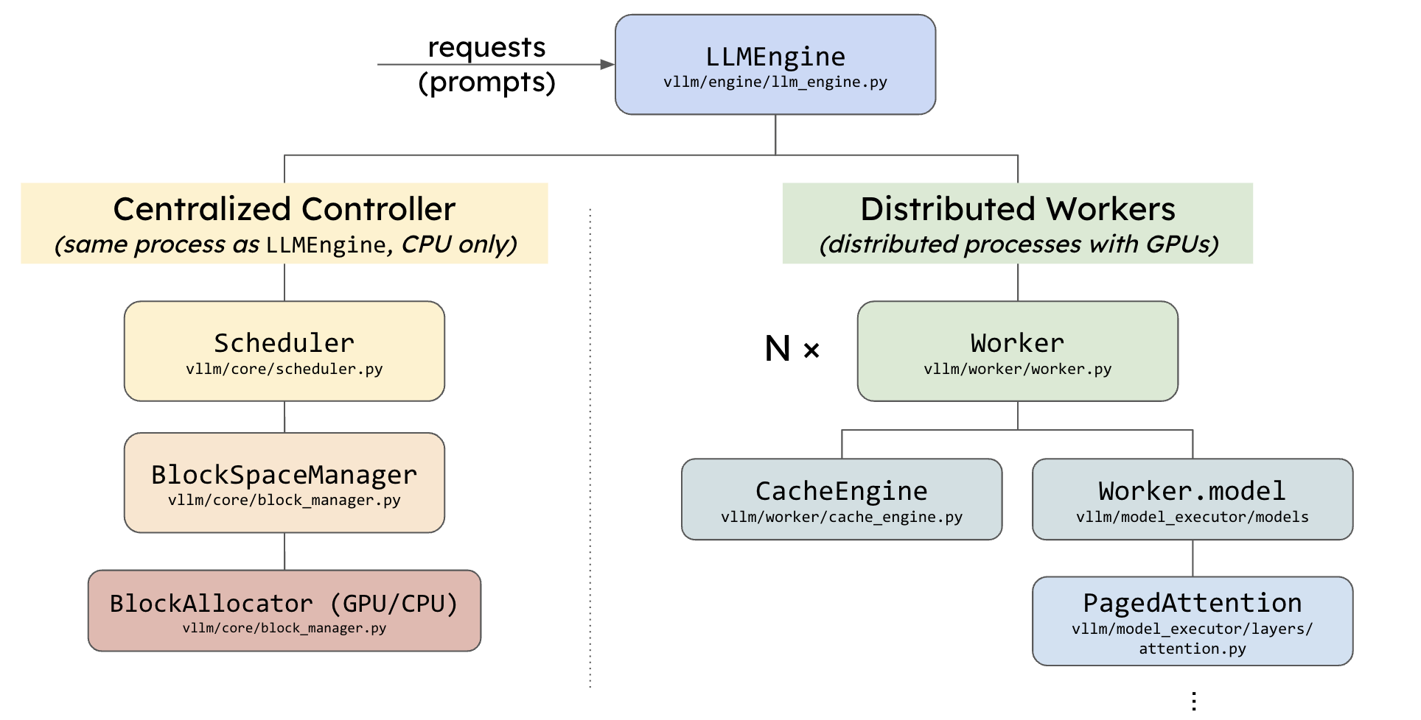
vLLM User Interface

Slide 11
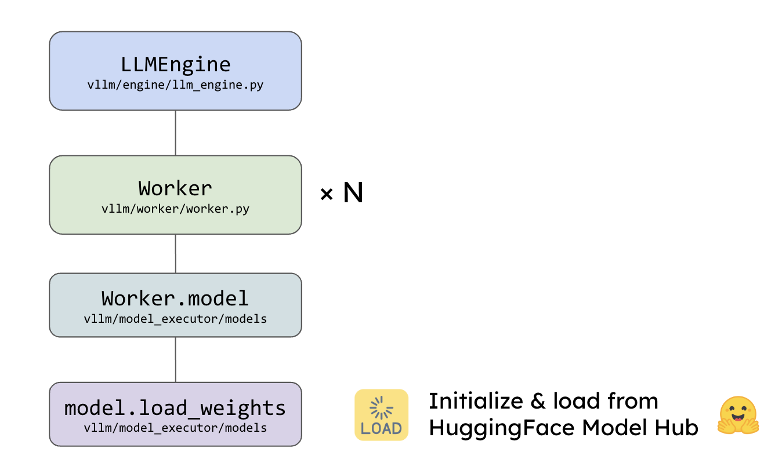
vLLM Before serving requests
1. Initialize & load model

Slide 12
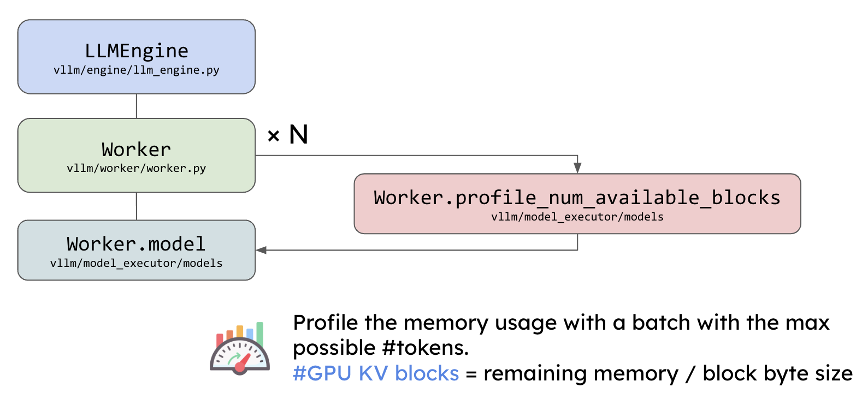
vLLM Before serving requests
2. Profile memory usage

Slide 13
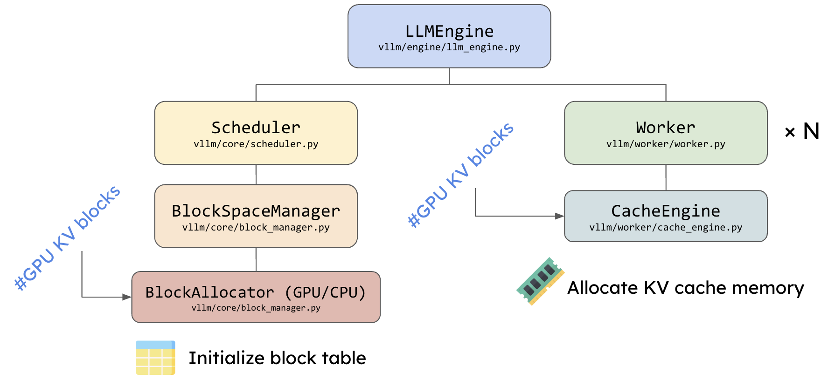
vLLM Before serving requests
3. Pre-allocate KV Blocks

Slide 14
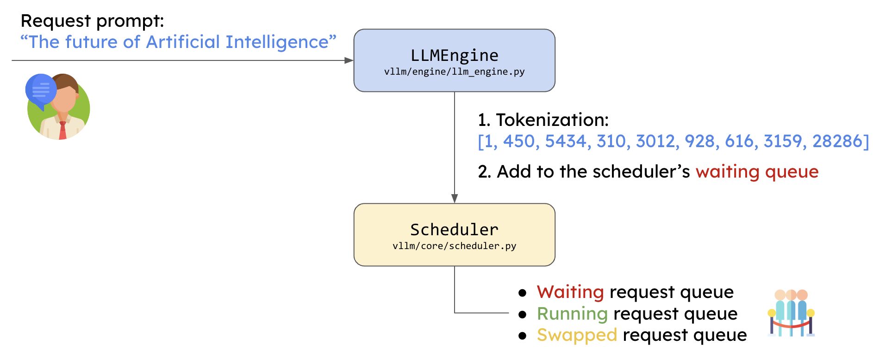
vLLM When requests arrive

Slide 15
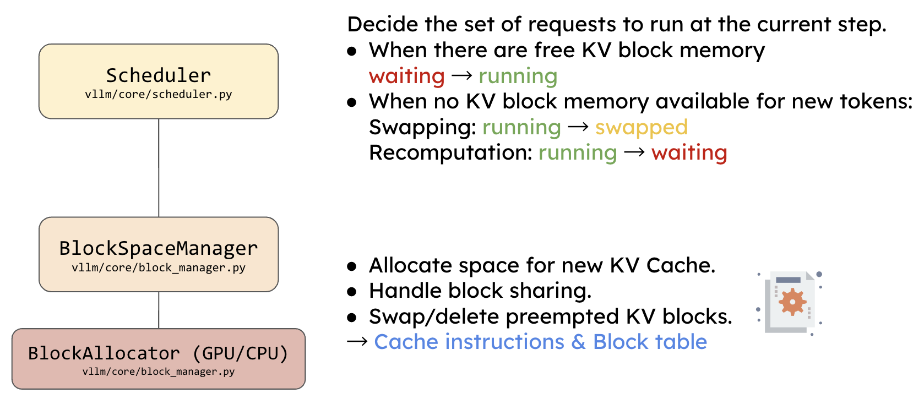
vLLM At every step, the scheduler

Slide 16
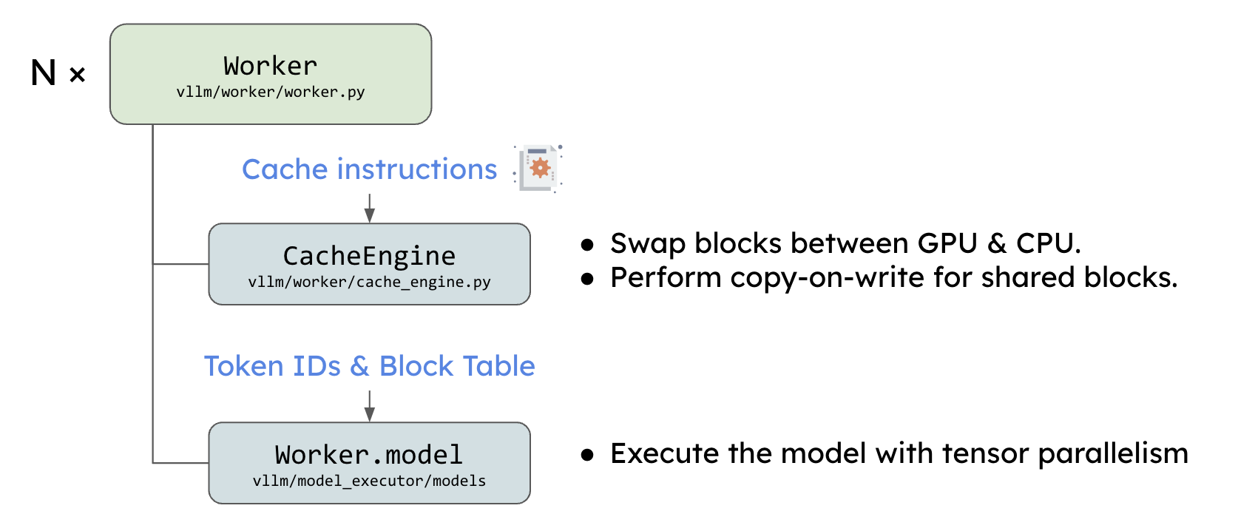
vLLM At every step, the scheduler

Slide 17
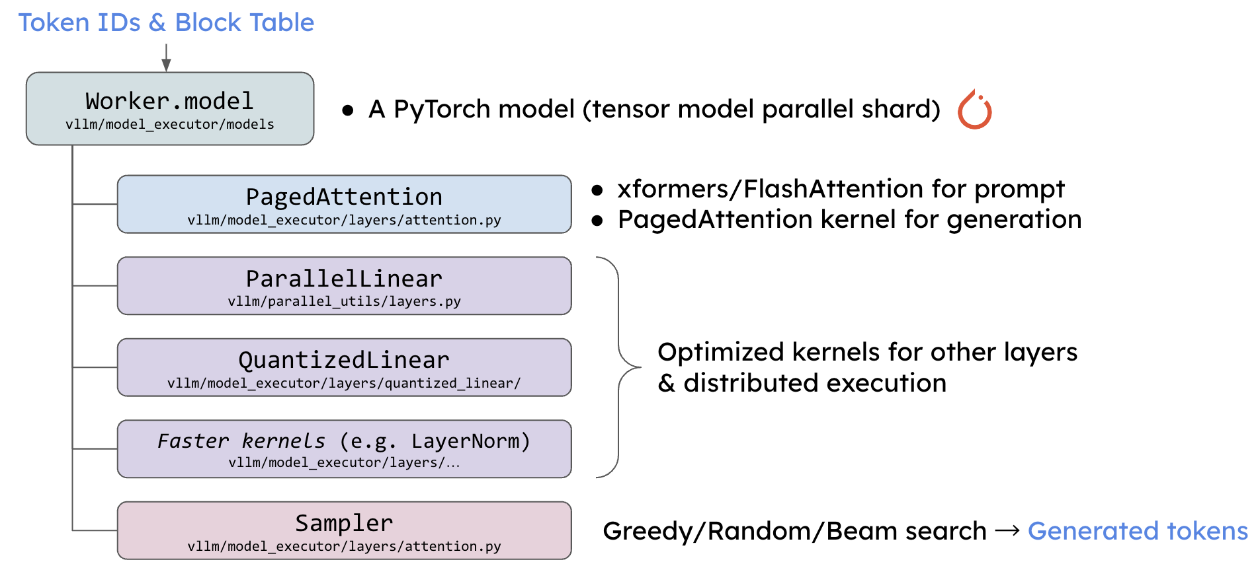
vLLM At every step, the scheduler

Slide 18
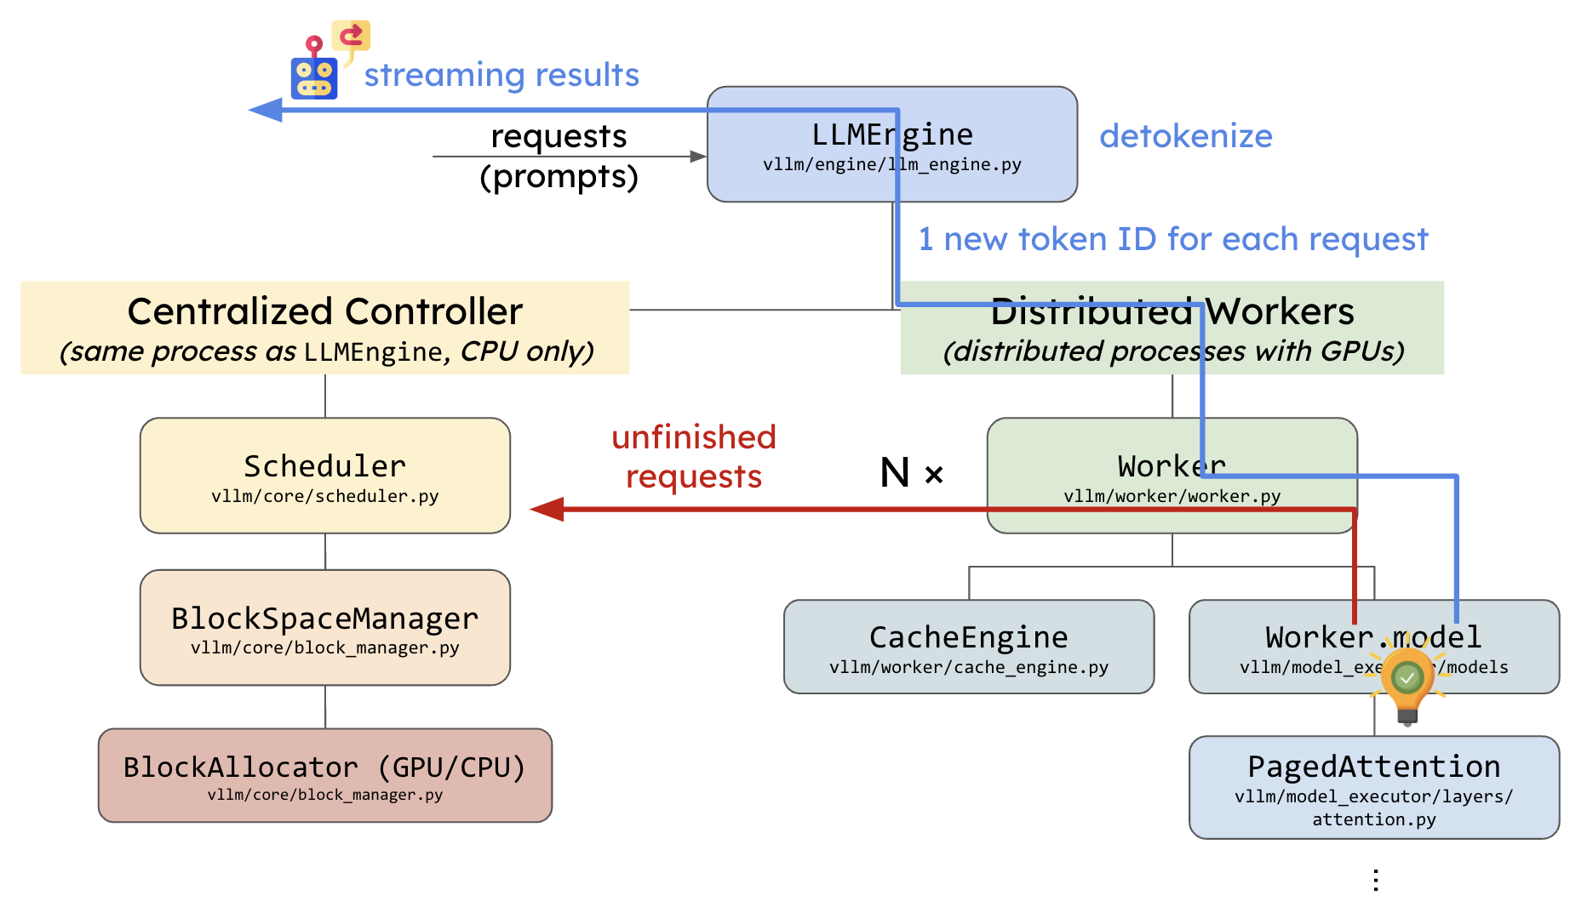
vLLM At every step, the scheduler

Slide 19
vLLM At every step, the scheduler
Core component: LLMEngine
Centralized controller → Distributed workers
Scheduler prepares the requests at each step
Workers run the model with PagedAttention

Slide 20
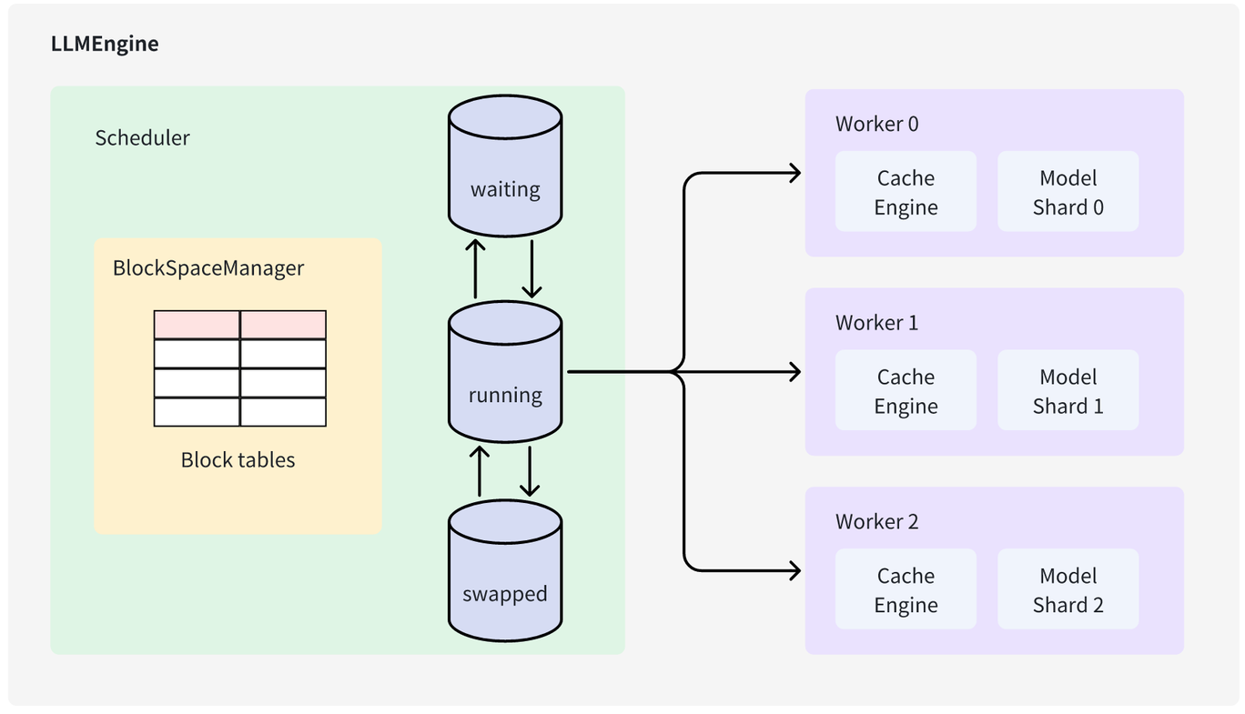
VLLM LLMEngine 2 Core
请求调度 Scheduler 等待队列中选择要处理请求
负责推理 Worker 使用模型对被调度请求进行推理

Slide 21
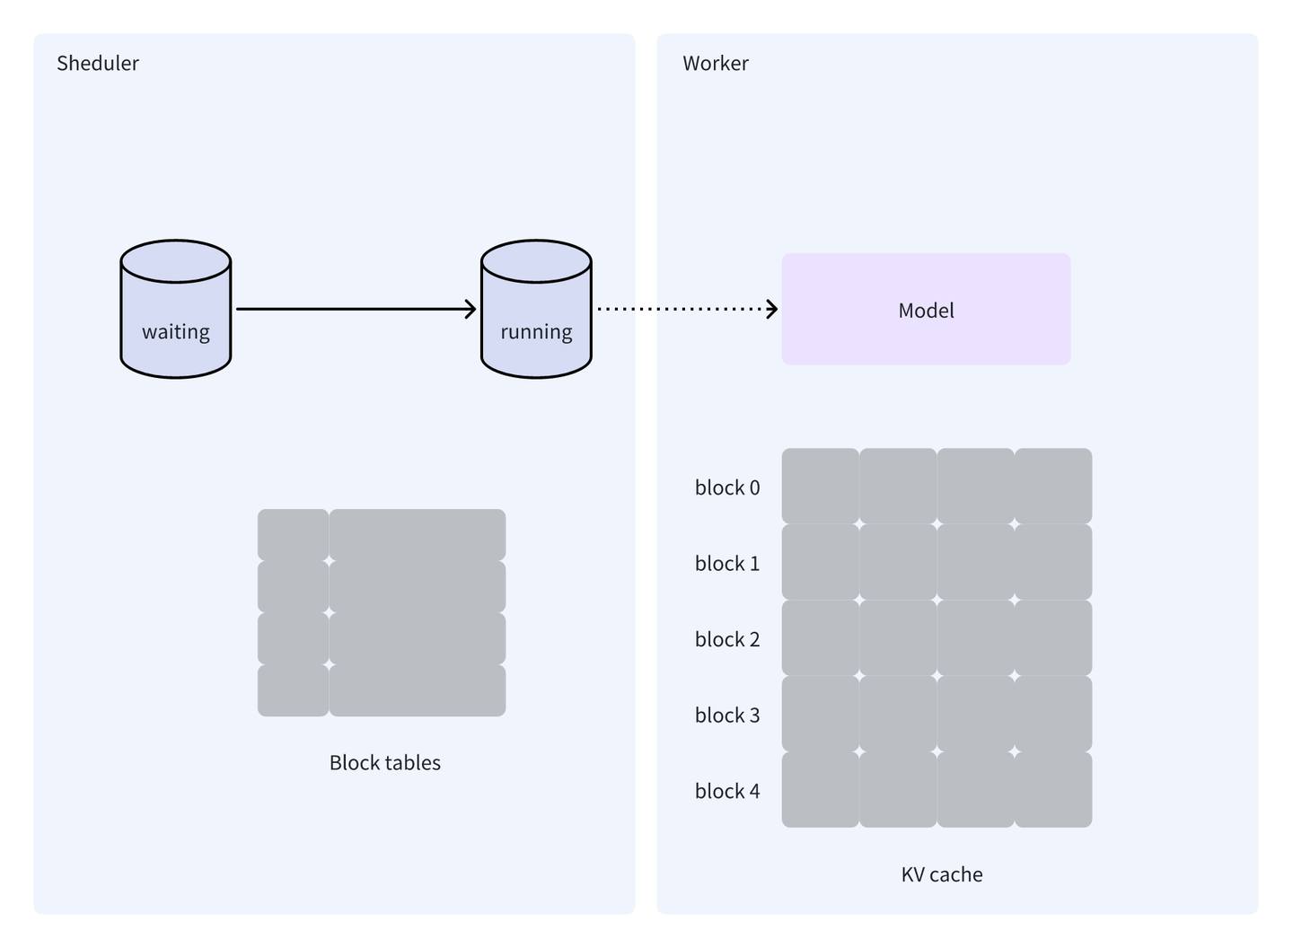
VLLM Worker Init

Slide 22
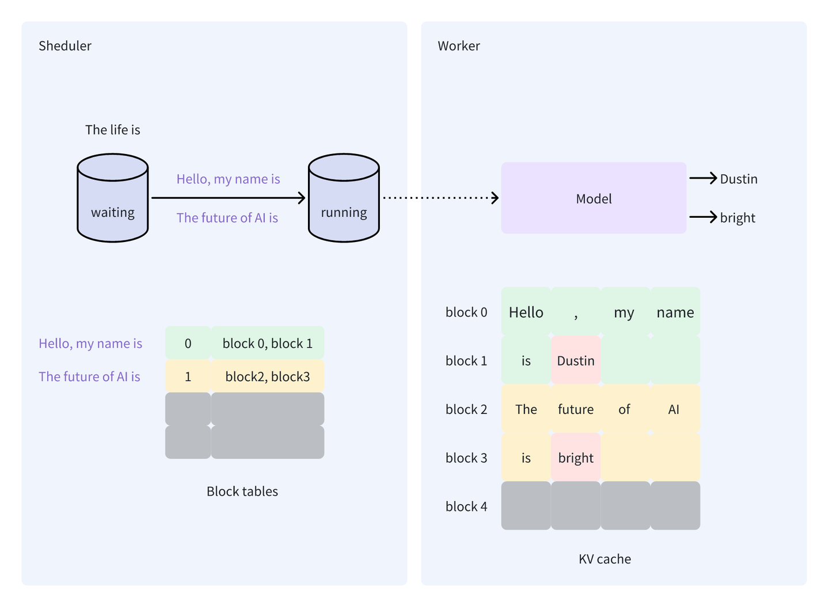
VLLM Worker 1th iter

Slide 23
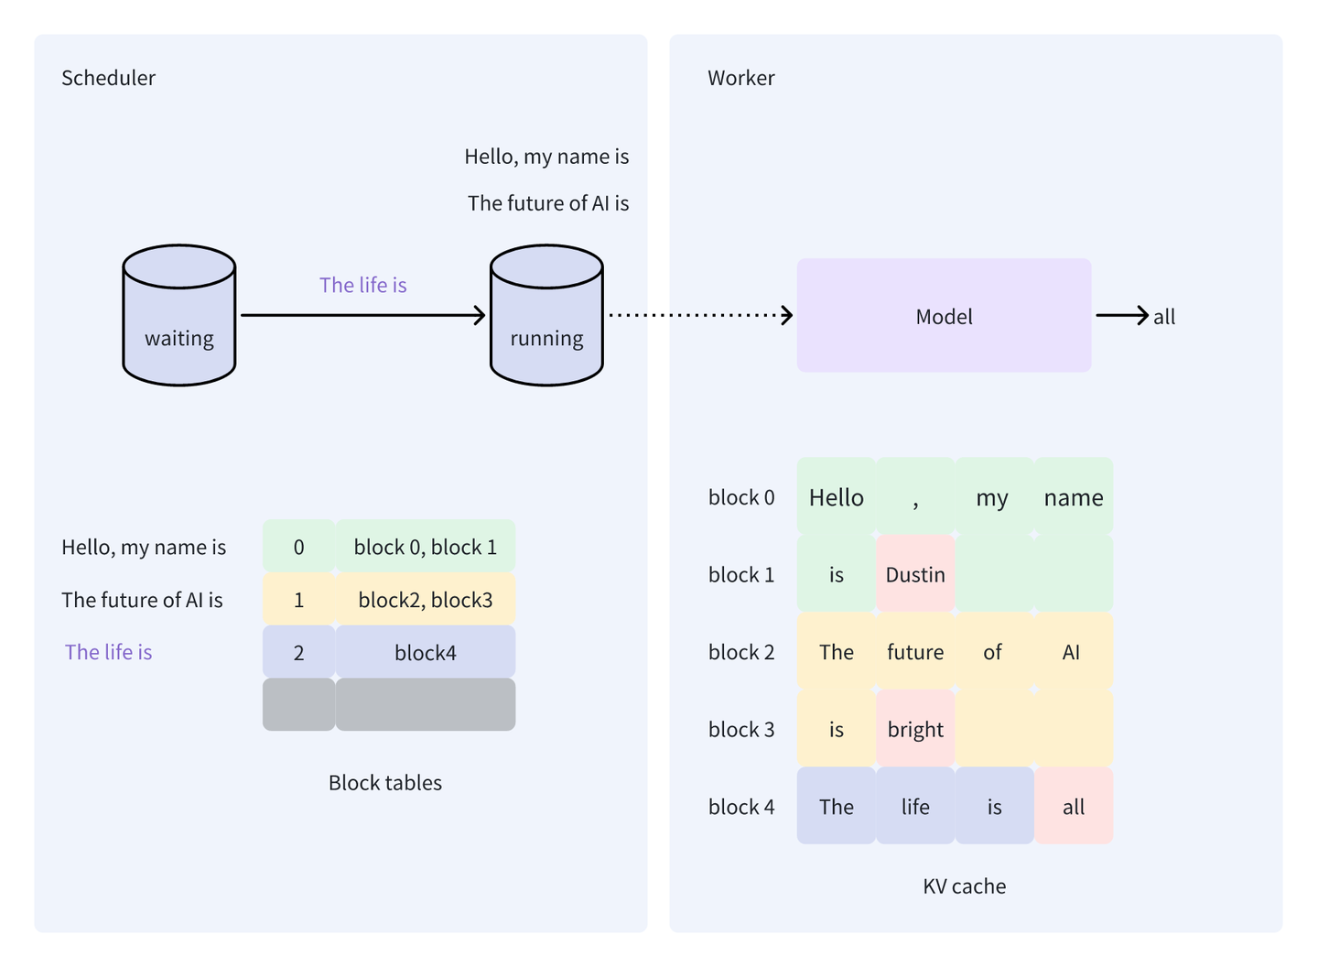
VLLM Worker 2th iter

Slide 24
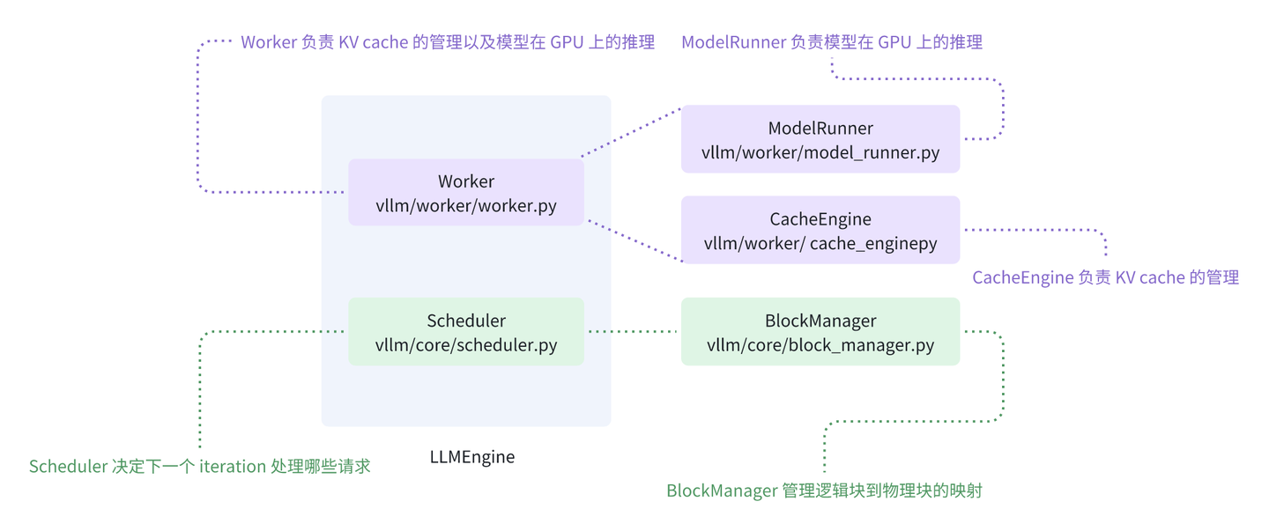
LLMEngine

Slide 25
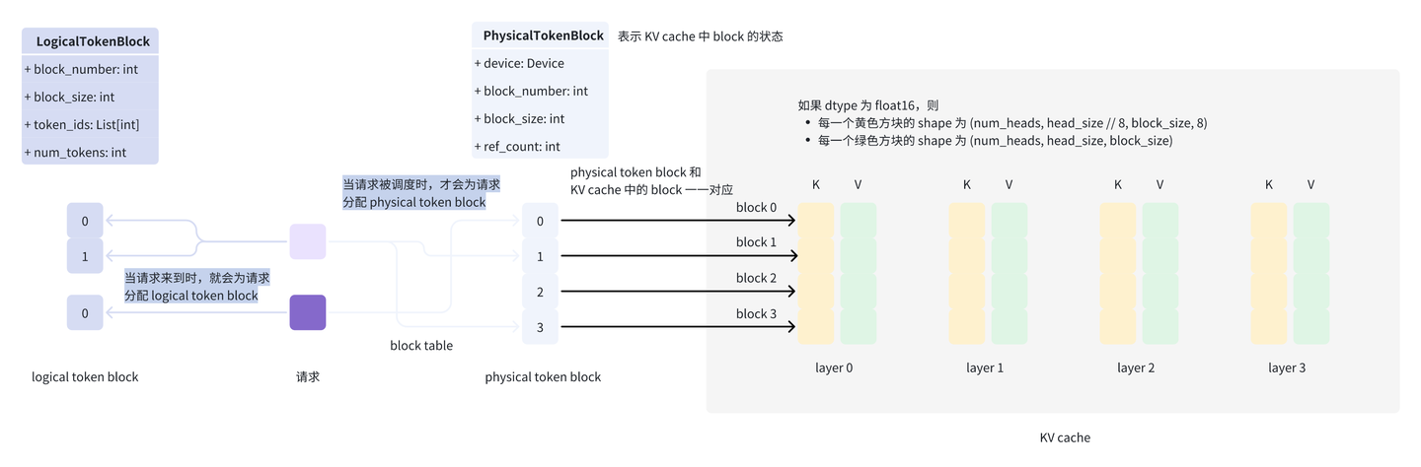
BlockSpaceManager

Slide 26
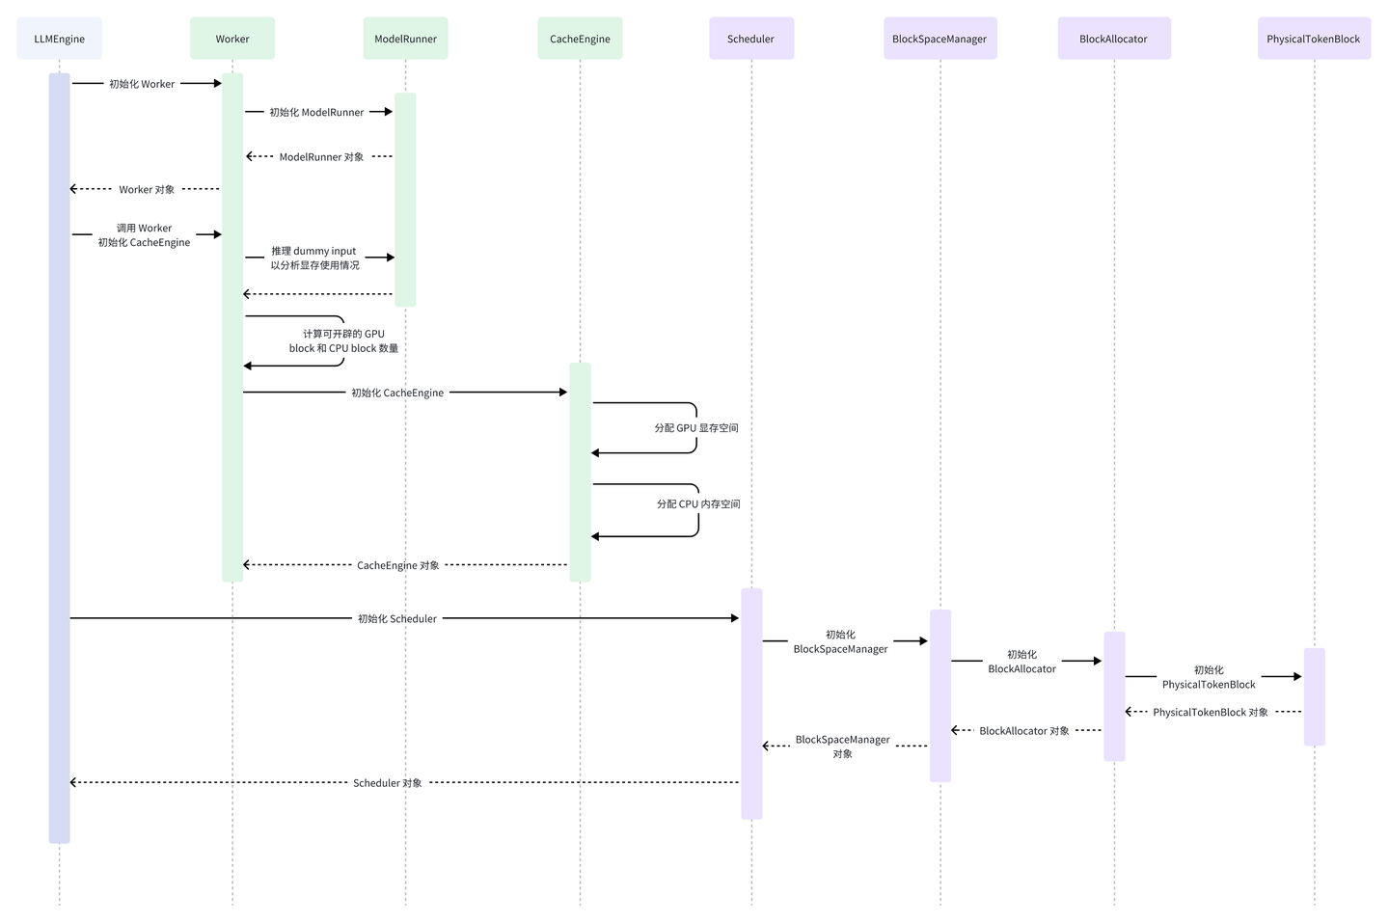
vLLM workload

Slide 27
